Slide 1
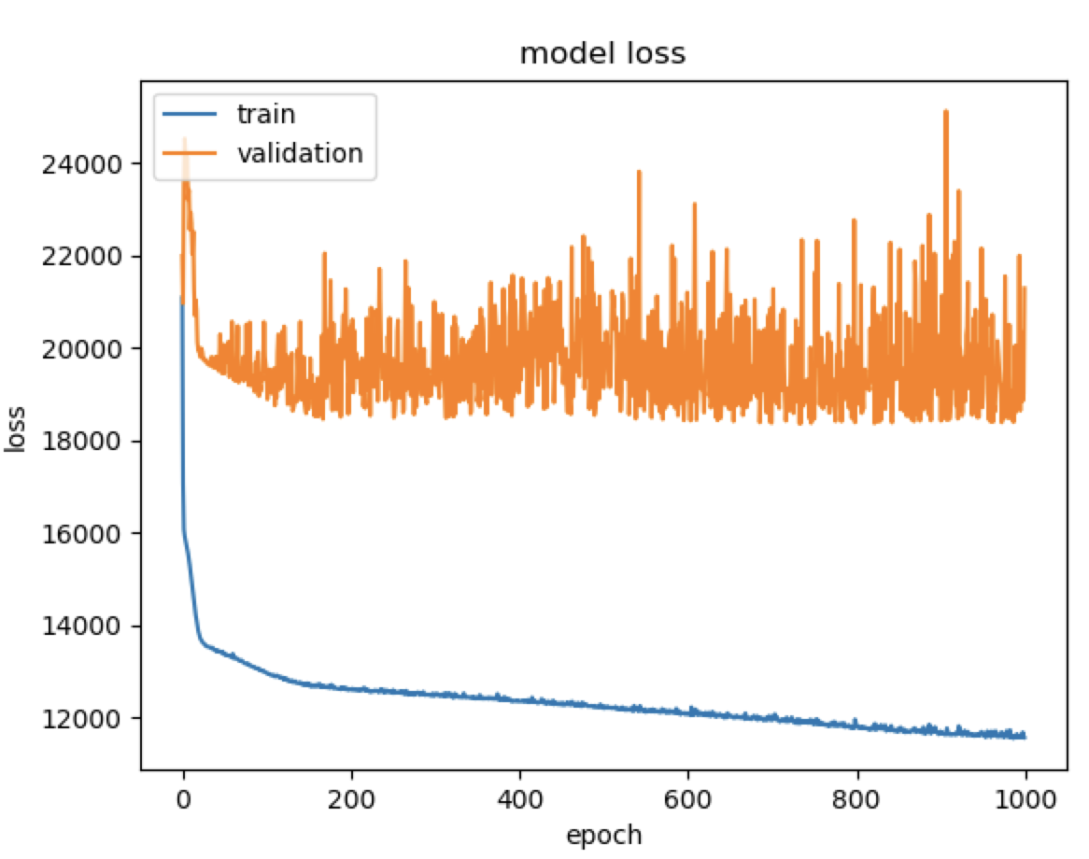
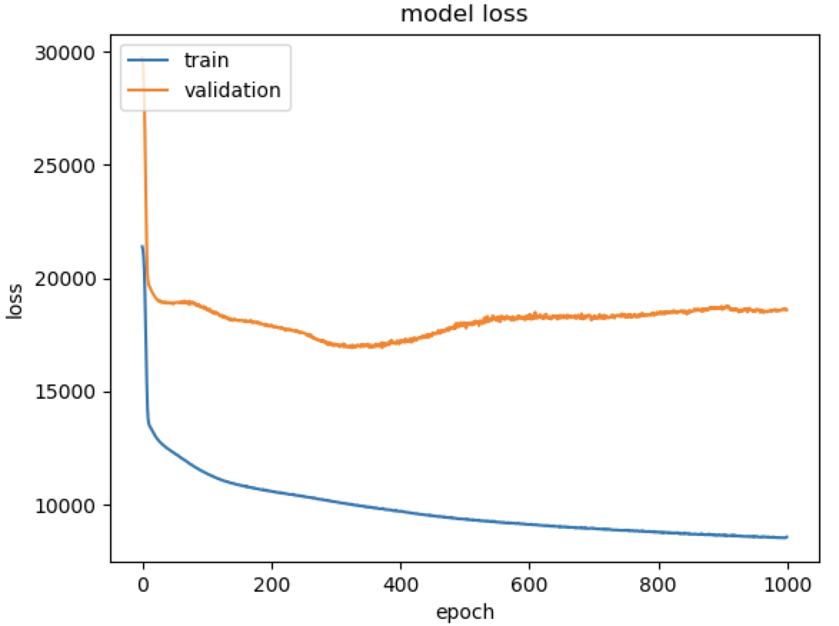
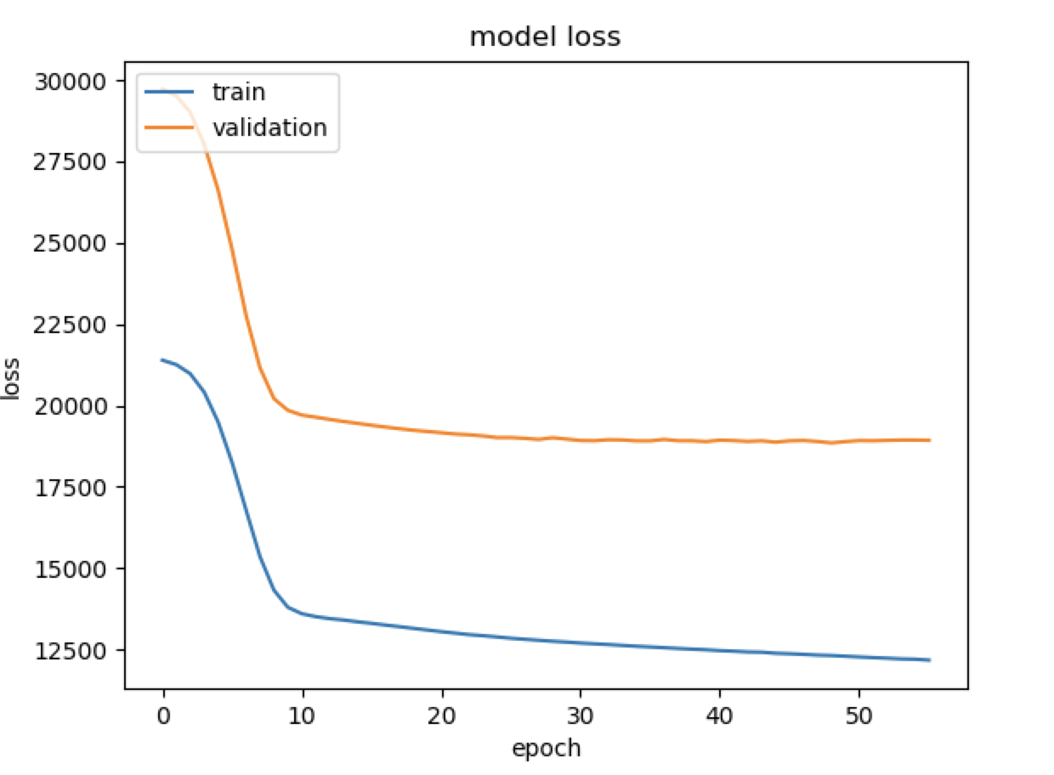

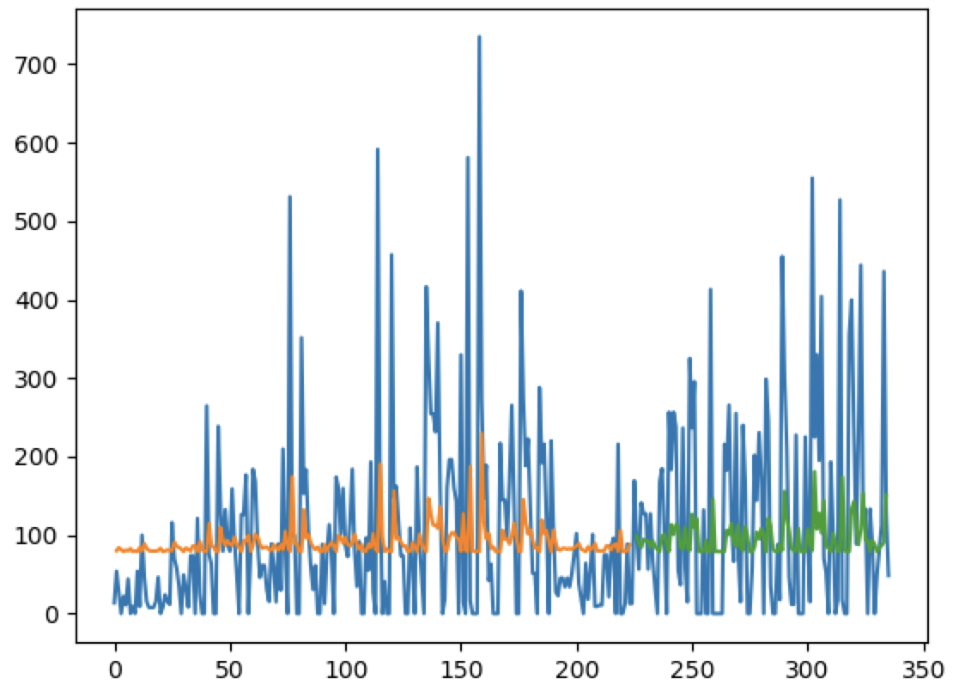
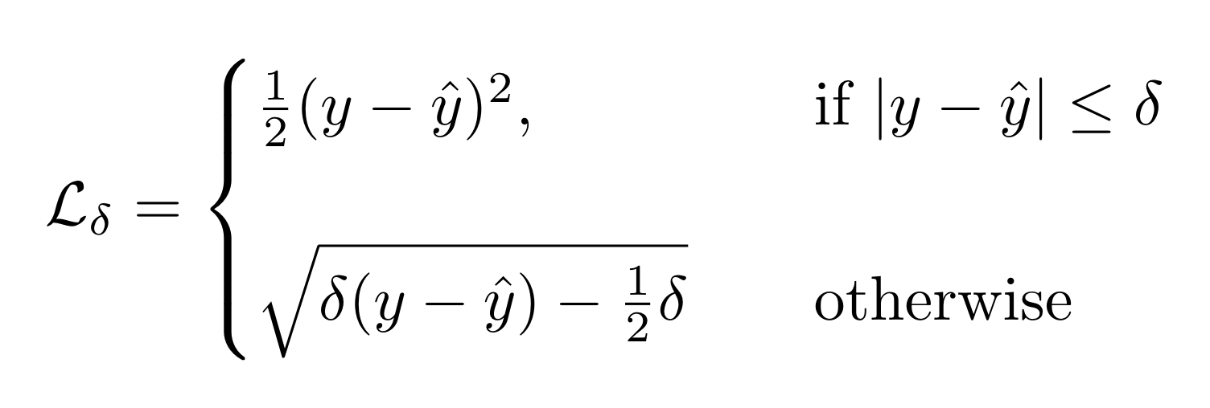
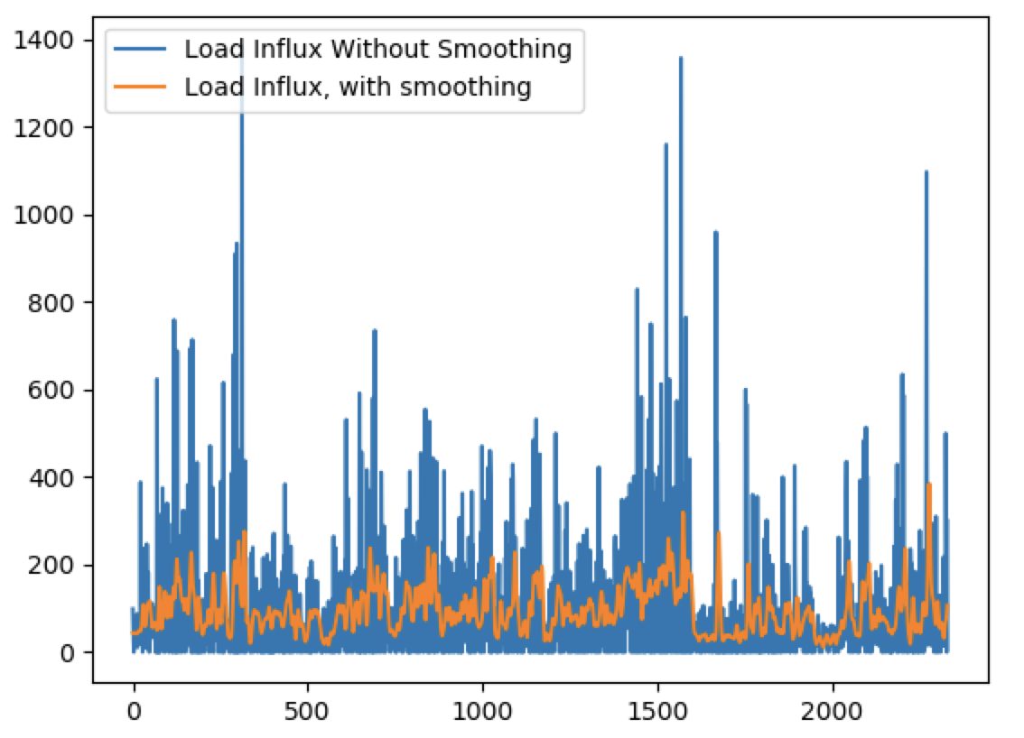
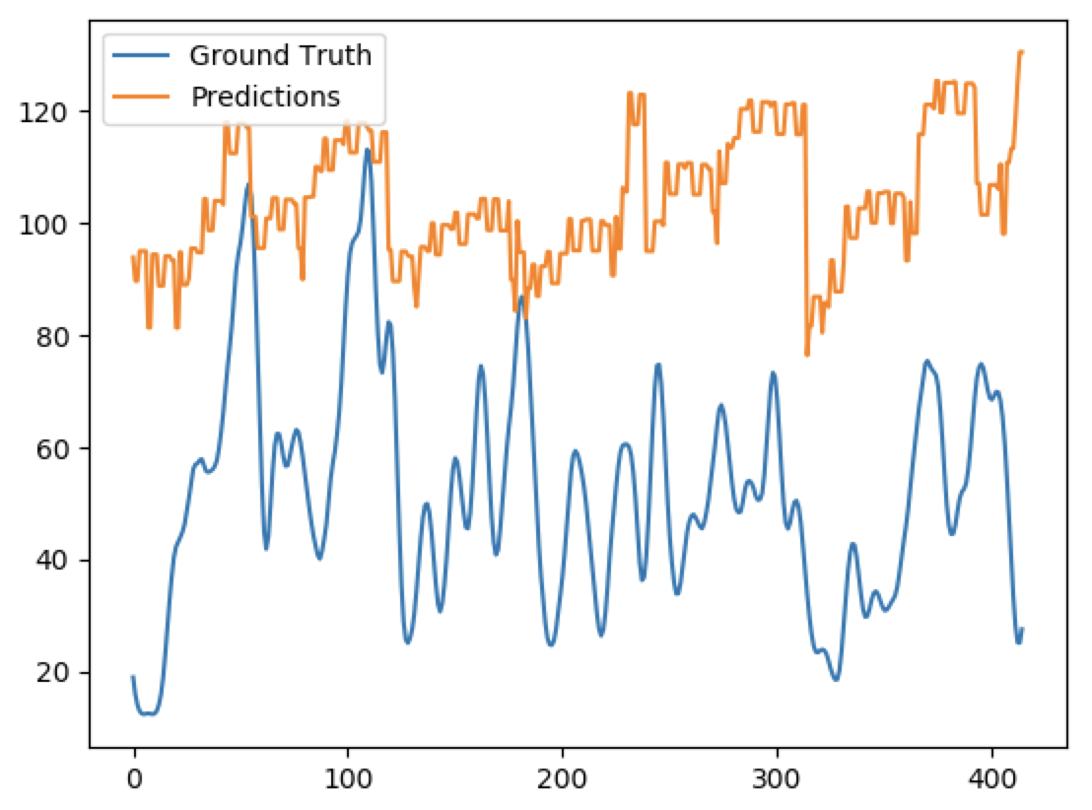
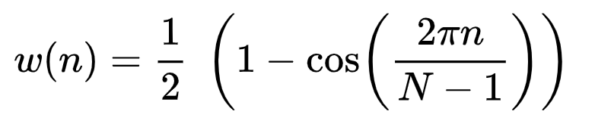
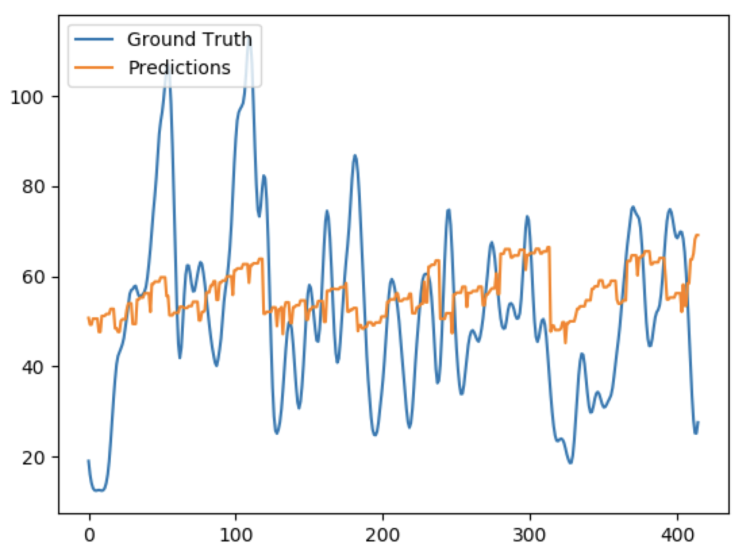
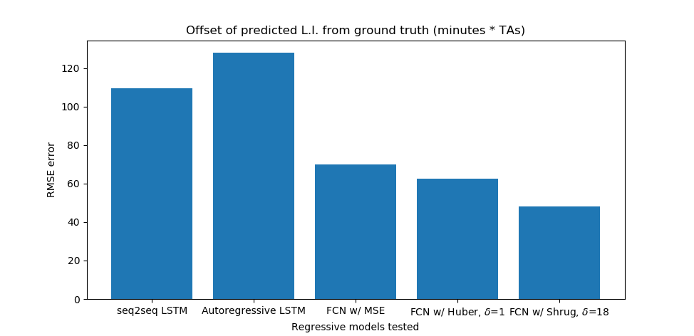
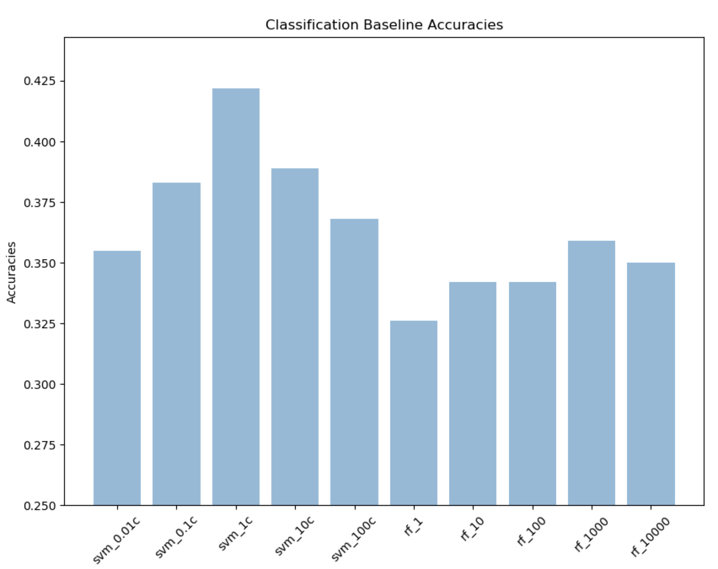
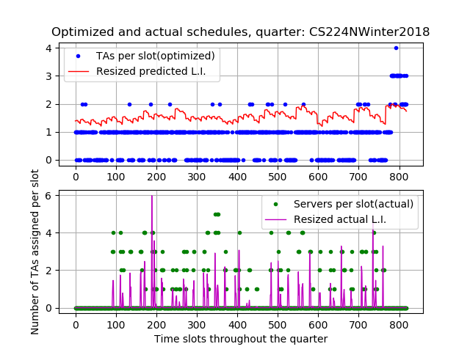
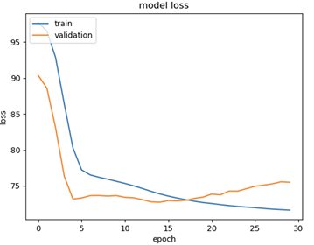
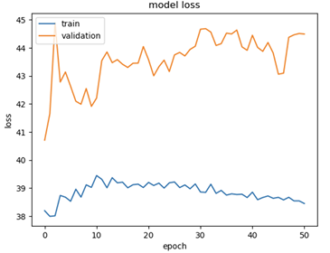
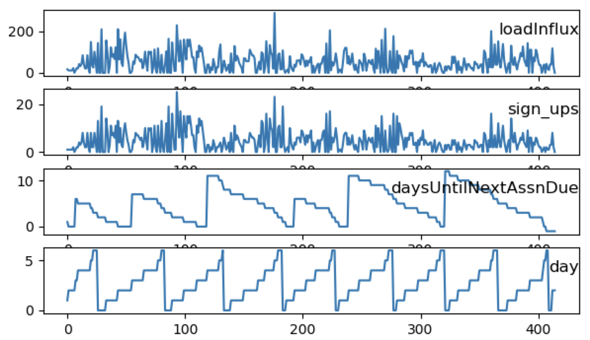
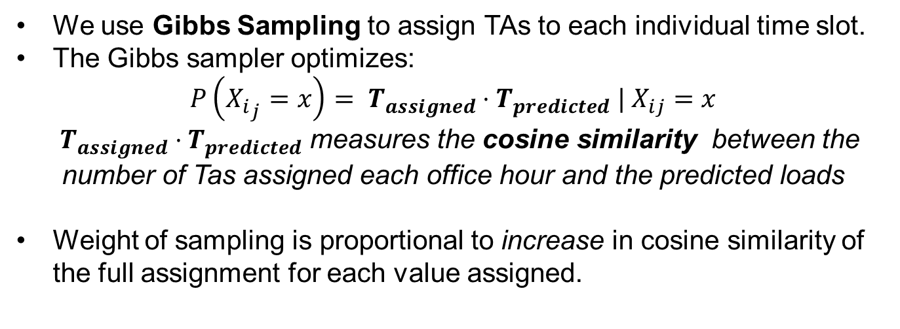
Without norm With normalization Norm + Early stopping
Deep Queue-Learning: A Quest to Optimize Office Hours
CS 221
Avoy Datta, Dian Ang Yap, Zheng Yan
CS 229 | Autumn 2018
CS 229
Initial mode (Univariate LSTM) predicts load influx spikes. (Blue- actual, orange – train predictions, green– validation predictions). Y-axis is the load influx, X-axis represents OH timeslots in chronological order.
Introduction
Methodology
Results
OHs often suffer from overcrowding and long wait times, stressing both students and instructors.
If we could accurately predict the expected workload at a given OH, TAs can be better allocated.
QueueStatus, Carta, and course syllabi provide a wealth of information that can be used.
We trained a neural network model that predicts student load influx (expected serve time * # sign-ups) at OH on an hourly basis, for any course.
With these predictions, we now optimize TA scheduling given realistic constraints.
We defined a new loss (Shrug loss) and used smoothing on labelled data to reduce penalty on outliers.
To reduce contributions by outliers, we smooth out the data through convolution with a Hann window:
Visualization of smoothed y-labels
Shrug loss reduces offset of predictions
MSE, with smoothing
Experiments
Shrug, with smoothing
Both classification (SVMs, Random Forest) and regression (fully connected nets, LSTMs) were experimented for predictions.
Smoothing reduces spikes in erratic data.
Less effective in predicting actual magnitude.
Class Statistics
Table 1: Statistics for sample of classes (4/8 shown)
Class | Quarter & Year | #OH-Active TAs | Total # Students | Total OH Hours | Total Served | Total Load Influx
CS107 | Spring 2017 | 13 | 184 | 415 | 1722 | 21873.09
CS161 | Spring 2017 | 6 | 93 | 204 | 875 | 15380.68
CS110 | Spring 2018 | 20 | 187 | 223 | 1749 | 35459.1
CS229 | Autumn 2018 | 17 | 634 | 369 | 1390 | 31733.7
Loss Functions w/ FCN | RMSE (Load Influx)
MSE | 69.89
MAE | 62.65
Huber (𝛿 = 1) | 62.61
Shrug (𝛿 = 18) | 48.0
Shrug yields significantly lower RMSE on test set, but poorer convergence during training.
Features and Preliminary Statistics
Training with Huber loss
Training with Shrug loss
Cosine similarity, actual schedule | Cosine similarity, optimized schedule
0.794 | 0.789
Load influx is significantly and positively correlated with:
Week number (r = 0.07) and Number of servers (r = 0.32)
Significantly and negatively correlated with: Days left until assignment due (r= -0.08), Hour of day (r = -0.10), Weekday (r=-0.09), Days until next exam (r = -0.06)
Summary
Scheduler
Using data scraped off of Stanford course resources, a fully connected NN, and Gibbs sampling, we have come up with a system that schedules TA hours (within realistic constraints) that appears to correlate well with student demand.
Major challenges for inference: figuring out a model that balanced bias with variance and coming up with a loss that didn’t penalize outliers excessively.
This model can serve as a recommender system for office hours for newly introduced courses. We tested it on one quarter of a course not used in the train set and found correlation between assigned hours and predicted influx were similar to actual load influx and server correlation.
We use Gibbs Sampling to assign TAs to each individual time slot.
The Gibbs sampler optimizes:
$$P\left({X_{i}}_{j}=x\right)= T_{assigned}⋅T_{predicted} | X_{ij}=x$$
${ T}_{assigned} ⋅T_{predicted}$ measures the cosine similarity between the number of Tas assigned each office hour and the predicted loads
Weight of sampling is proportional to increase in cosine similarity of the full assignment for each value assigned.
.
[1]
[2]
[3]

